Slide 1
Information for livestock stakeholders Livestock exports or movements to the EU and Northern Ireland from Great Britain from 2021 – changes to the country code displayed on livestock ear tags
Issued: November 2020

Slide 2
ID tags for livestock moved from GB to the EU or Northern Ireland (Options from 1 January 2021)
From 1 January 2021, the UK will trade with the EU as a third country.
New rules for entry into the EU of certain animals and products including livestock will also apply then.
This means that we will have to use a different country code to identify livestock exported to EU Member States.
The UK currently uses the visual code ‘UK’ in accordance with EU rules for Member States. From 2021, we will need to include a the ISO¹ country code ‘GB’ for animals intended for export to the EU.
EU Health Certificates for imports of animals from third countries must show individual ID, type of ID used and the ISO country code GB.
Under the Northern Ireland Protocol, movements of these live animals from Great Britain to Northern Ireland will also need to meet these requirements.
¹ International Standardisation Organisation

Slide 3
Options from 1 January 2021
For cattle, sheep, or goats
For animals already identified (i.e. with UK tags) - an additional ear tag showing ‘GB’ followed by the animal’s existing individual ID number
or
For new-born as yet unidentified animals – apply tags(s) with the GB suffix displayed after UK and the animal’s ID number.
For pigs
The existing requirement for a single export tag or ear tattoo is unchanged – but you must now apply a tag with the GB suffix displayed after UK and the animal’s herd + ID number.
So what does this look like in practice . . . ?

Slide 4
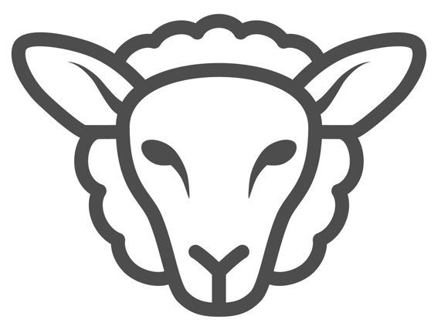
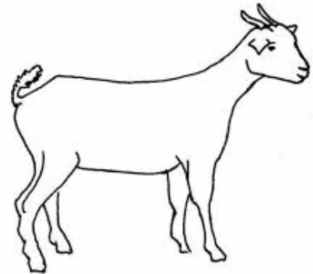
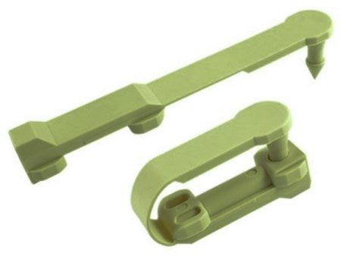
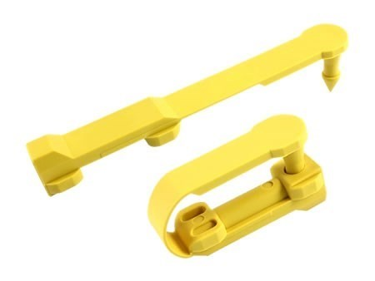
Sheep – already identified with a UK tag pair
Animal’s existing tag pair (1 will be in each ear)
The mandatory EID tag is yellow
Single new additional ‘GB’ management tag
(No prescription as to colour other than it shouldn’t be yellow – reserved for UK EID tags)
Same 12 digit individual no. printed on all the tags following the visual country code (in this case: 0 37842 00123 )
An EID chip in the yellow tag contains the same number – preceded by the ‘826’ (the ISO numeric code for UK or GB)
This illustration uses loop tags other types (e.g. flag or button) are available.
Same rules apply for goats

Slide 5
Sheep – not already identified (or lambs being upgraded from the slaughter/batch tag)
New tag pair (1 applied to each ear)
The mandatory EID tag is yellow
Same 12 digit individual number (in this case: 0 37842 00123 ) printed on both tags - between the two visual country codes. An EID chip in the yellow tag contains the same number – preceded by the ‘826’ (the ISO numeric code for UK and GB)
For lambs upgraded away from the birth holding both the tags must be red – a visual indicator that their original ID was replaced after leaving the birth holding. (To be recorded in the replacing keeper’s holding register).
This illustration uses loop tags other types (e.g. flag or button) are available.
Same rules apply for goats

Slide 6
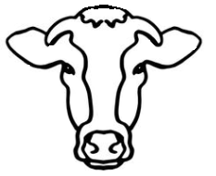
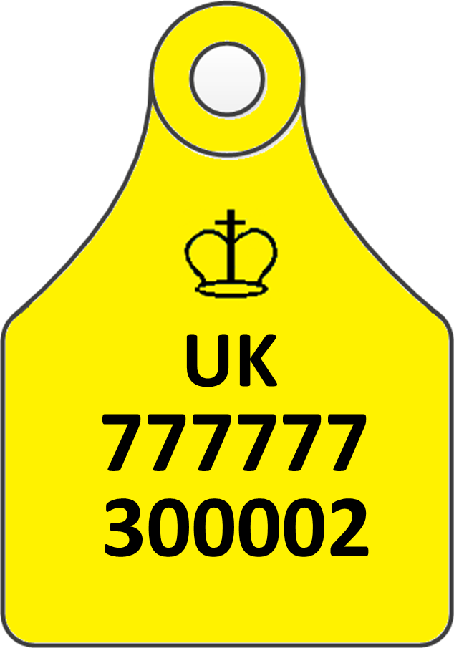
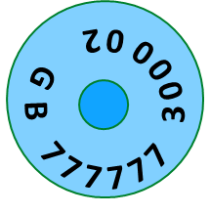
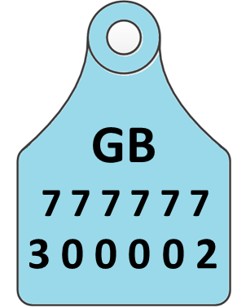
Cattle – already identified with a UK tag pair
+
‘GB’ + the animal’s existing ID number is printed on a 3rd management tag
‘GB’ is printed on a 3rd management tag along with the animal’s existing ID number
Button and flag tag options
G B 7 7 7 7 7 7 3 0 0 0 0 2

Slide 7
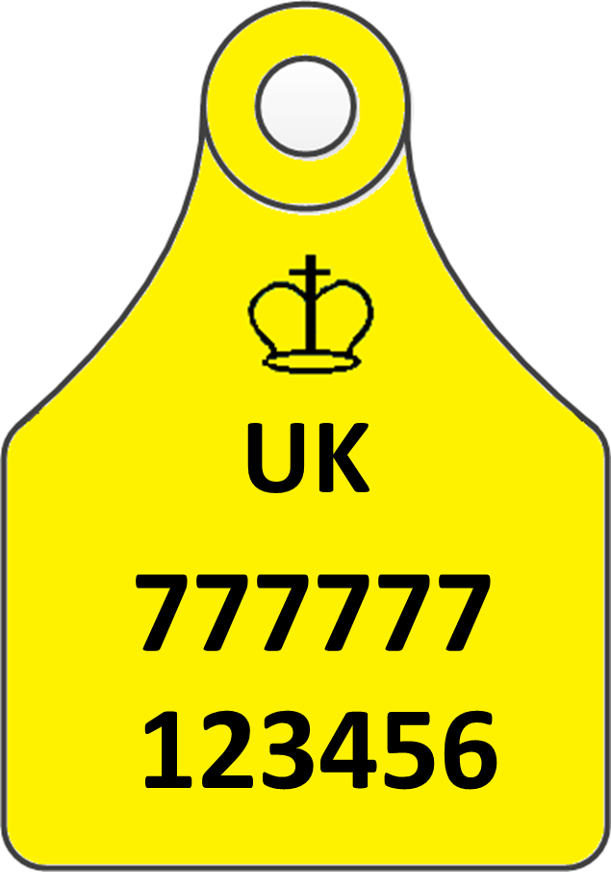
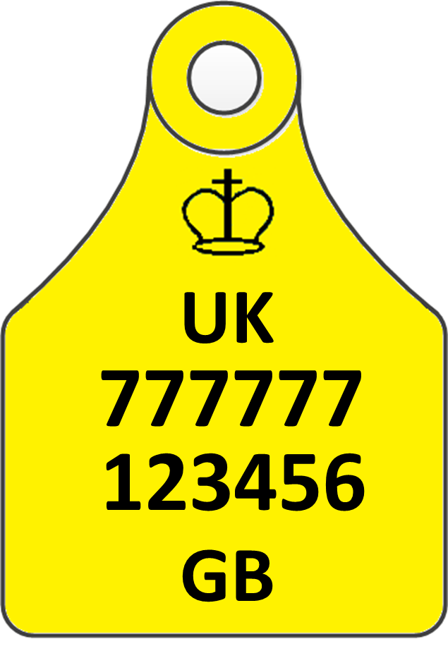
Cattle – not already identified with UK tags
Secondary tag
Primary tag

Slide 8
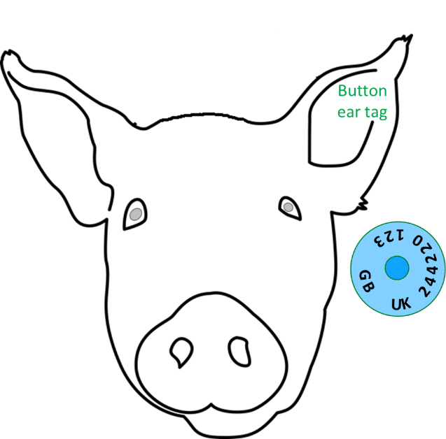
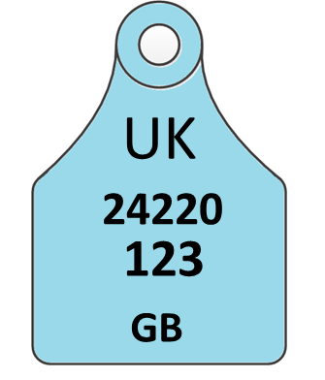
Pigs
Most pigs are batch identified with:
double slap marks (one on each front shoulder) displaying an alpha-numeric herd mark e.g. AB1234, or a single ear tag displaying this mark
Some may have been individually identified if moving to shows or AI Centres (e.g. AB1234 – 9).
Export pigs are presently identified with a (single) ear tag displaying UK + herd mark + individual number.
From 2021, for pigs exported or moved to the EU or NI this tag will additionally also have ‘GB’ printed on it.
No prescription on tag type
G B UK 2 4 4 2 2 0 1 2 3
Alternative option
is a tattoo in the ear
displaying the same information

Slide 9
Ordering GB tags – Process
Keeper contacts tag supplier to order GB tags for export
Tag supplier asks if GB tags are for existing tagged or new born cattle, sheep, goats or for pigs
Supplier prints / produces the GB tag/s
Keeper / exporter records that in their holding register
Keeper / exporter applies GB tag/s
Posts / couriers to arrive promptly in the normal way
Movement to export recorded / reported in the usual way
Export Health certificate completed and signed by OV
Process est. 3-6 days depending on speed of tag production and post/courier service, etc.

Slide 10
How will exports and movements from Scotland, Wales and Northern Ireland be identified?
Exports and movements of livestock to the EU and Northern Ireland from Scotland and Wales from 2021 will be identified in the same way as those from England.
Livestock can continue to move from Northern Ireland to Great Britain using their UK tags.
For exports from Northern Ireland to the EU, you will need to contact DAERA.

